Slide 1
WINDOWS,FRAMES AND OVERLAYS

Slide 2
WINDOWS
JavaScript’s Window object represents the browser window, or potentially frame, that a document is displayed in.
The properties of a particular instance of Window might include its size, amount of chrome—namely the buttons, scroll bars, and so on—in the browser frame, position, and so on.
The methods of the Window include the creation and destruction of generic windows and the handling of special-case windows such as alert, confirmation, and prompt dialogs.

Slide 3
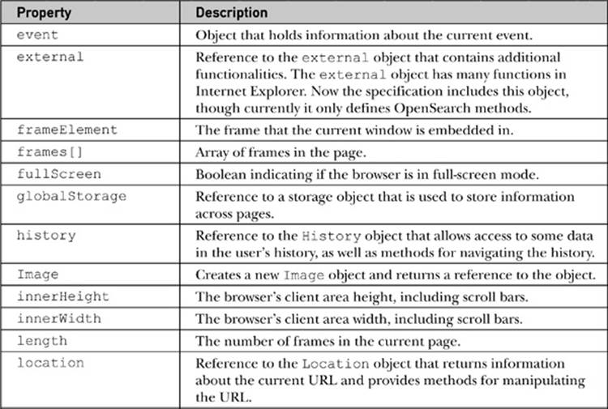
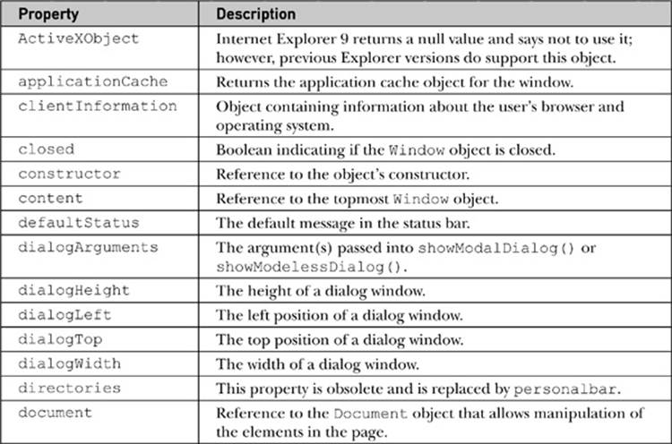
window Properties and Objects

Slide 4
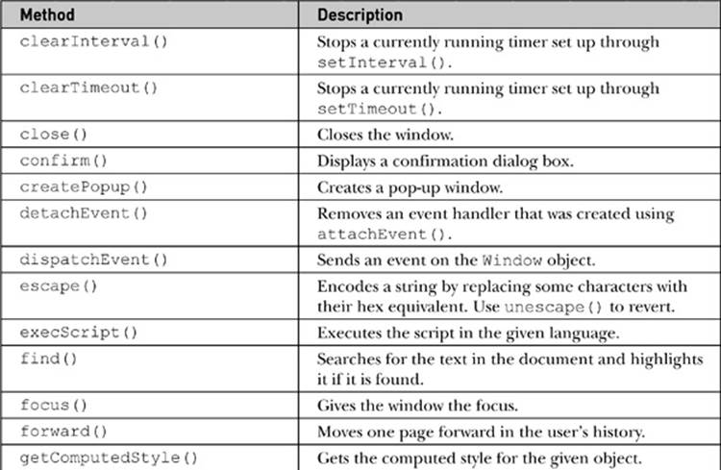
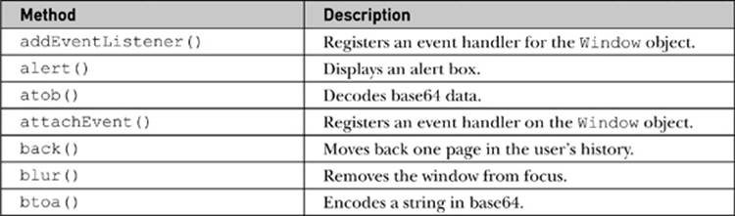
window Methods

Slide 5
Dialogs
To create three types of special windows known generically as dialogs.
A dialog box, or simply dialog, is a small window in a graphical user interface that “pop ups,” requesting some action from a user.
The three types of basic dialogs supported directly by JavaScript include alerts, confirms, and prompts.

Slide 6
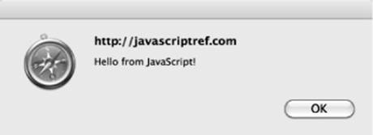
alert( )
The Window object’s alert() method creates a special small window with a short string message and an OK button, as shown here:
or, for shorthand, we just use
The basic syntax for alert is

Slide 7
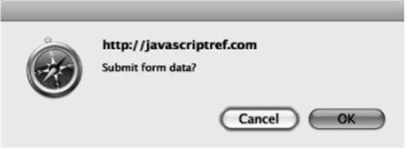
confirm( )
The confirm() method creates a window that displays a message for a user to respond to by pressing either an OK button to agree with the message or a Cancel button to disagree with the message.
A typical rendering is shown here:
The basic syntax of the confirm() method is
or simply,

Slide 8
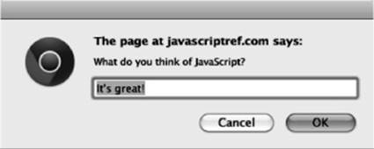
prompt( )
A prompt window invoked by the prompt() method of the Window object is a small data collection dialog that prompts the user to enter a short line of data, as shown here:
The prompt() method takes two arguments. The basic syntax is shown here:
The first parameter is a string that displays the prompt value, and the second is a default value to put in the prompt window.
The method returns a string value that contains the value entered by the user in the prompt.

Slide 9
The shorthand prompt() is almost always used instead of window.prompt(), and occasionally programmers will accidentally use only a single value in the method:
However, in many browsers you may see that a value of undefined is placed in the prompt line.
You should set the second parameter to an empty string to keep this from happening:
When using the prompt() method, it is important to understand what is returned. If the user presses the Cancel button in the dialog or the close box, a value of null will be returned. It is always a good idea to check for this.
Otherwise, a string value will be returned.
Programmers should be careful to convert prompt values to the appropriate type using parseInt(), parseFloat(), or another type conversion scheme if they do not want a string value.

Slide 10
Opening and Closing Generic Windows
While the alert(), confirm(), and prompt() methods create specialized windows quickly, it is often desirable to open arbitrary windows to show a Web page or the result of some calculation.
The Window object methods open() and close() are used to create and destroy a Window, respectively.
When you open a Window, you can set its URL, name, size, buttons, and other attributes, such as whether or not the window can be resized.
The basic syntax of this method is

Slide 11
URL is a URL that indicates the document to load into the window.
name is the name for the window (which is useful for referencing it later on using the target attribute of HTML links).
features is a comma-delimited string that lists the features of the window.
replace is an optional Boolean value (true or false) that indicates whether or not the URL specified should replace the window’s contents. This would apply to a window that was already created.
A simple example of this method is

Slide 12
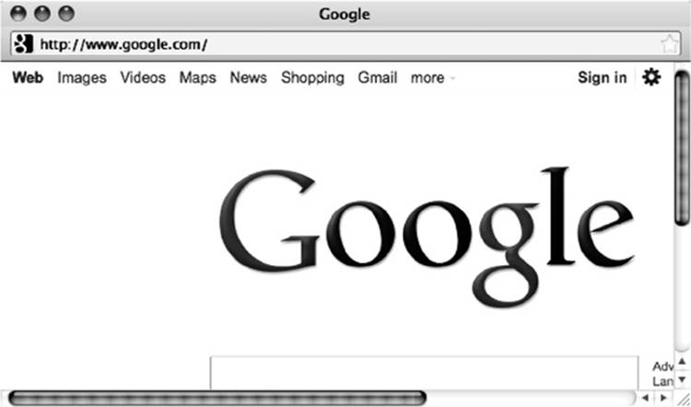
This would open a window to Google with a height of 300 pixels, a width of 600 pixels, and scroll bars, as shown here:
Once a window is open, the close() method can be used to close it.

Slide 13
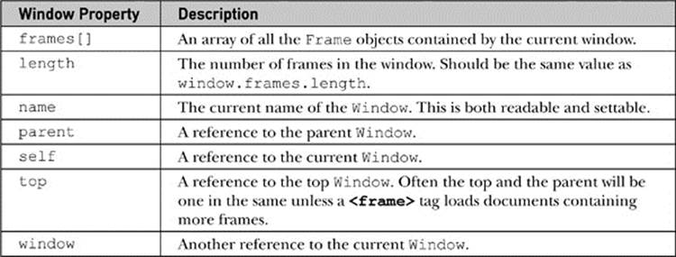
Frames: A Special Case of Windows
When a browser window contains multiple frames, it is possible to access each of the separate Window objects through window.frames[], which is an array of the individual frames in the window.
The basic properties useful for manipulating frames are,

Slide 15
The major challenge using frames and JavaScript is to keep the names and relationships between frames clear so that references between frames are formed correctly.
In this case, the window containing this document is considered the parent of the three frames (frame1, frame2, and frame5). While you might expect to use a value such as
you probably will actually run the script from within a child frame to determine the number of frames in the window. Thus, you would actually use

Slide 16
or just
The parent property allows a window to determine the parent window.
To access a particular frame, we can use both its name as well as its position in the array, so the following would print out the name of the first frame, which in our case is “frame1”:
We could also access the frame from another child frame using parent.frame1, or even parent.frames[“frame1”], using the associate array aspect of an object collection.
Remember that a frame contains a window, so once you have this you can then use all of the Window and Document methods on what the frame contains.

Slide 17
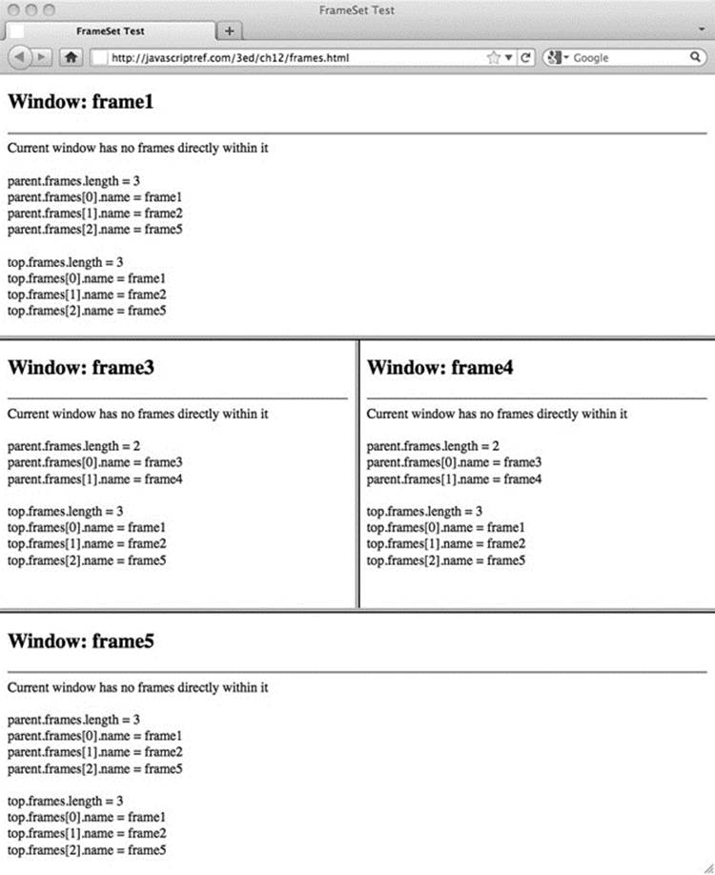

Slide 18
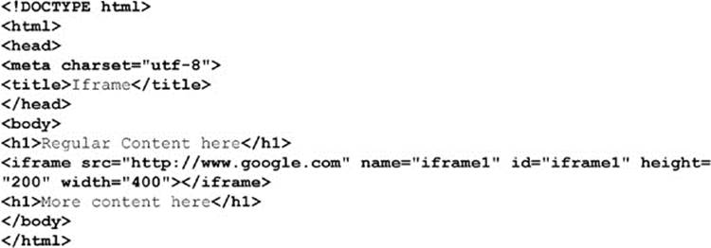
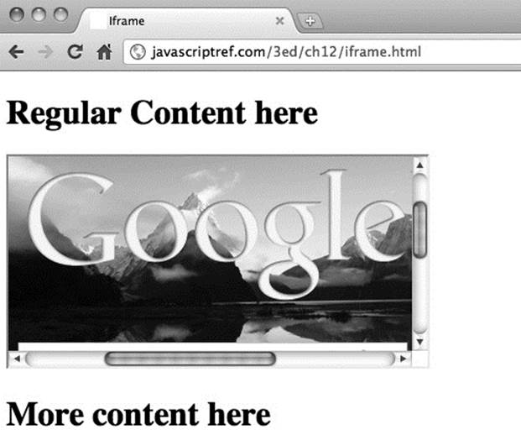
Inline Frames
One variation of frames that deserves special attention is the <iframe>, or inline frame, because it is preserved under HTML5. The idea with an inline frame is that you can add a frame directly into a document without using a frameset. For example, this example
produces a page something like this:

Slide 19
Applied Frames
Now that we are familiar with frame naming conventions, it is time to do something with them. In this section, we present some solutions for common frame problems and hint at the larger issues with frame usage.
Loading Frames
A common question developers have with HTML is how to load multiple frames with a link. XHTML provides the target attribute to target a single frame, such as framename, like so:
Frame Busting
While frames can be very useful for building some complex user interfaces and comparing documents, they also can cause Web designers significant problems.

Slide 20
Frame Building
The converse problem to the one solved by frame busting would be to avoid having framed windows displayed outside of their framing context. This occasionally happens when users bookmark a piece of a frameset or launch a link from a frameset into a new window. The basic idea would be to have all framed documents make sure they are inside of frames by looking at each window’s location object, and if they are not, to dynamically rebuild the frameset document.

Slide 21
Overlays Instead of Windows
Simple dialogs such as alert() and prompt() lack customization.
You may opt to try to create custom dialogs using the generic window.open() method.
However, in either case, the dialogs may be blocked by browser-based or third-party pop-up blockers installed by the user.
To address both the customization concerns and pop-up blockers, many designers have turned to what we dub “div dialogs,” named for the HTML <div> tag used to create them.
Using CSS, designers can position <div> tag–based regions over content and customize them visually in whatever manner they like.

